Slide 1
Advanced Phishing Techniques
Name: R Yuktha
Domain : Cyber Security

Slide 2
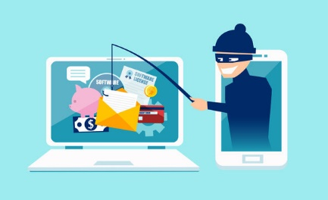
Introduction to Phishing
Definition: Phishing is a type of cyberattack where malicious actors impersonate a legitimate entity or use deceptive tactics to trick individuals into divulging sensitive information such as usernames, passwords, credit card numbers, or other personal data. The goal of phishing is typically to gain unauthorized access to systems, steal personal information, or commit financial fraud.

Slide 3
Introduction to Phishing
Purpose of Phishing Attacks: The primary purpose of phishing attacks is to steal sensitive information, gain unauthorized access to systems, or install malware on a victim's device.
Statistics on Phishing Incidents: Provide statistics on the prevalence and impact of phishing attacks globally.
For example:
According to the Anti-Phishing Working Group (APWG), there were over 241,000 unique phishing attacks reported in 2021.
Phishing attacks are responsible for billions of dollars in financial losses annually across industries.
Industries like finance, healthcare, and government are frequent targets due to the valuable data they possess.

Slide 4
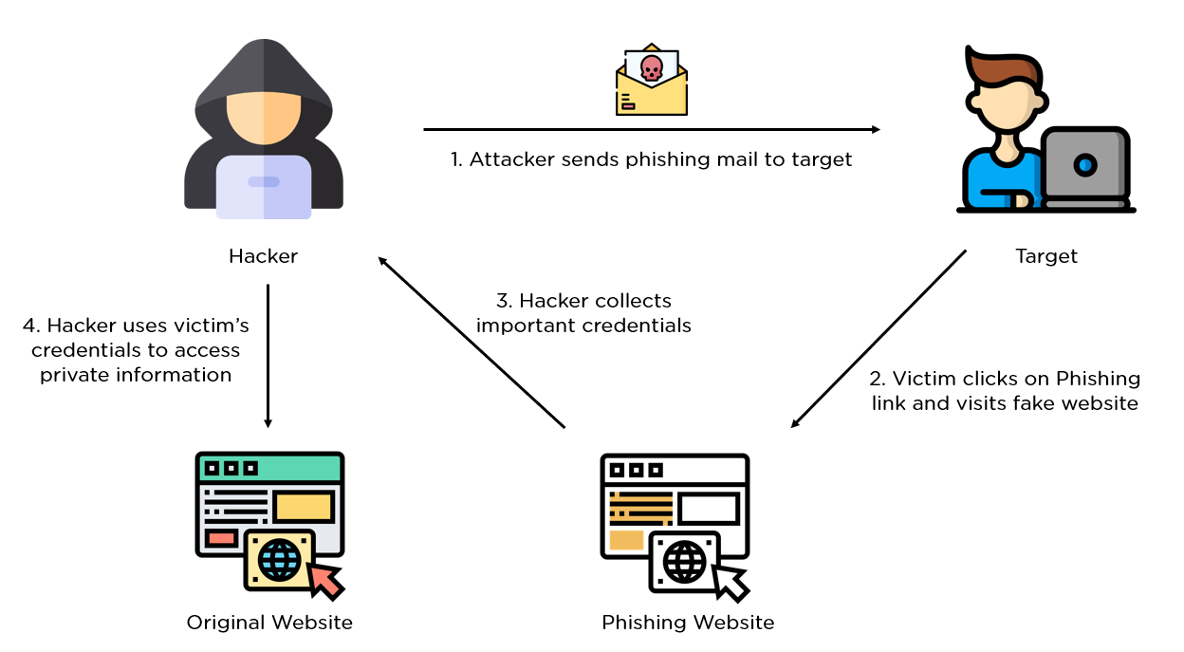
Process of Phishing Attack

Slide 5
Types of Phishing Techniques
Spear Phishing
Whaling (CEO Fraud)
Clone Phishing
Pharming

Slide 6
Spear Phishing
Definition and Characteristics: Spear phishing is a targeted form of phishing where attackers customize their messages to specific individuals or organizations. Unlike regular phishing, spear phishing is more personalized and often appears to come from a trusted source.
Examples of Recent Attacks:
The SolarWinds attack, where malicious actors sent spear phishing emails to specific employees to gain access to the SolarWinds software build system.
Business email compromise (BEC) attacks targeting financial executives with requests for fund transfers.
Tactics Used by Attackers: Tactics include researching targets on social media to personalize emails, using spoofed email addresses that appear legitimate, and crafting urgent or compelling messages to prompt quick action.

Slide 7
Whaling (CEO Fraud)
Definition and Target Audience: Whaling, also known as CEO fraud, targets high-level executives or individuals in positions of authority within organizations. Attackers impersonate executives to trick employees into transferring funds or revealing sensitive information.
Case Studies: Notable examples of CEO fraud include:
The Ubiquiti Networks incident, where attackers used CEO fraud to steal $46 million through unauthorized wire transfers.
The Snapchat incident, where an employee unknowingly sent payroll information to attackers posing as the CEO.
Common Tactics: Tactics include spoofing email addresses of executives, creating a sense of urgency, and exploiting the authority and trust associated with executive positions.

Slide 8
Clone Phishing
Explanation and Methodology: Clone phishing involves creating a replica of a legitimate email or website to deceive recipients. Attackers clone a previously sent email (often from a known contact or organization) and replace links or attachments with malicious ones.
Real-life Examples: Examples include:
Attackers cloning emails from banking institutions, requesting users to update their login credentials through a malicious link.
Cloning emails from ecommerce platforms, asking recipients to review an order status with a link leading to a phishing site.
Exploitation Methods: Attackers exploit trust in known entities or contacts to deceive recipients into disclosing sensitive information or downloading malware.

Slide 9
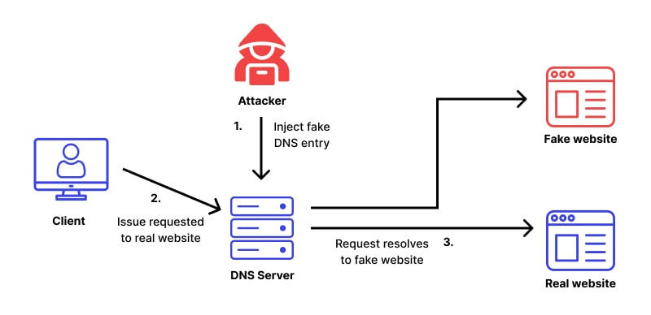
Pharming
Overview and Differences: Pharming redirects users from legitimate websites to fraudulent ones without their knowledge or consent. Unlike phishing, which relies on deceptive emails or links, pharming alters DNS settings or uses malware to redirect users.
Techniques: Techniques include DNS cache poisoning, where attackers manipulate DNS servers to redirect users to malicious sites, and malware infections that modify local host files to achieve the same.
Impact: Pharming can lead to financial losses through unauthorized transactions, compromise user credentials, and damage organizational reputations by associating them with fraudulent activities.

Slide 10
Disadvantages of Phishing
Financial Losses: Phishing attacks result in billions of dollars in financial losses annually through fraud, unauthorized transactions, and remediation costs for affected organizations.
Legal and Compliance Issues: Organizations may face legal repercussions for failing to protect customer data or complying with data protection regulations following a phishing incident.
Reputational Damage: Phishing incidents can damage an organization's reputation by undermining customer trust, leading to decreased customer loyalty and potential loss of business.

Slide 11
Impact of Phishing Attacks
Financial Impact: Phishing leads to direct financial losses, response costs, and regulatory fines.
Trust Impact: It undermines consumer trust, leading to decreased confidence and potential customer loss.
Legal Consequences: Organizations face fines, legal fees, and lawsuits due to data breach implications.
High-Profile Cases: Examples like Equifax and Yahoo highlight widespread impact and damage.
Lessons Learned: Emphasizes the need for proactive cybersecurity and transparent communication.
Economic Impact: Phishing lowers consumer spending, boosts cybersecurity investments, and raises regulatory costs.

Slide 12
How to Prevent Phishing Attacks
Security Training: Educate employees to spot phishing and report suspicious activities.
Multi-Factor Authentication (MFA): Add extra security layers for accessing sensitive information.
Email Filters and Anti-Phishing Software: Block suspicious emails before they reach employees.
Regular Security Audits: Identify and fix security gaps before they're exploited.
Employee Education: Keep teaching employees about new phishing tactics and why security policies matter.
Incident Response Plan: Plan and practice how to react to phishing incidents.
Partnering for Security: Work with experts for better threat detection and response.

Slide 13
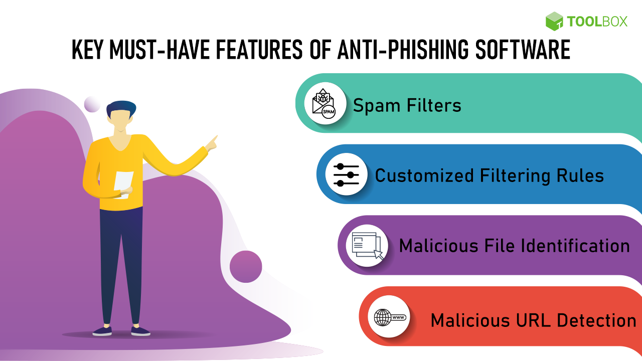
Technology for Phishing Prevention
Advanced Threat Detection: Use AI and analytics to catch phishing emails in real-time.
Phishing Simulations: Test how employees handle fake phishing attempts to improve their response.
AI in Detection: AI and machine learning make spotting and stopping phishing faster and more accurate.

Slide 14
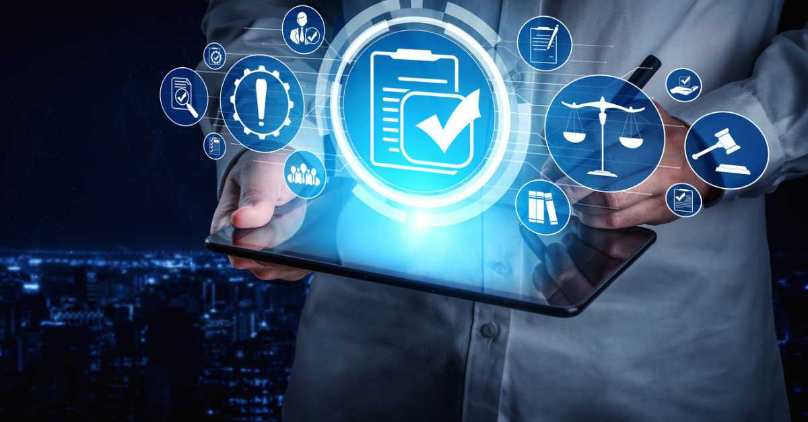
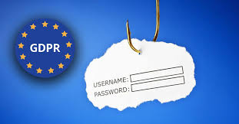
Legal Compliance and Phishing
GDPR and Your Data: Protect personal data from phishing attacks or face fines.
Data Protection Laws: Use encryption and controls to keep customer data safe.
Consequences of Non-Compliance: Fines, lost trust, and damage to your reputation.

Slide 15
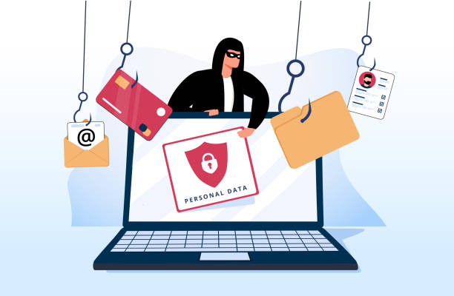
Conclusion
Importance of Proactive Phishing Defense Strategies: Stress the importance of adopting proactive strategies, including education, technology, and compliance, to defend against evolving phishing threats effectively.
Call to Action: Encourage organizations to strengthen their cybersecurity posture by implementing robust prevention, detection, and response measures to mitigate the risk of phishing attacks. short simple and humanise

Slide 16
Thank You

